Slide 1
Group 4: R5IM Loss and BLM Peak Finders
07.07.23
Rory, Vlad, Tejas, Heidi and Jonah
RAL Visitor Centre

Slide 2





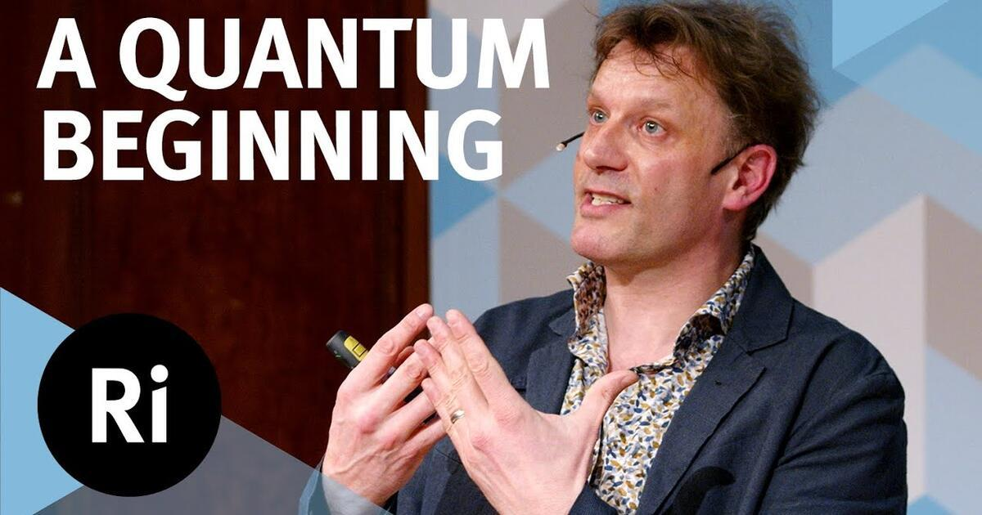
Tejas Dabke

Slide 3
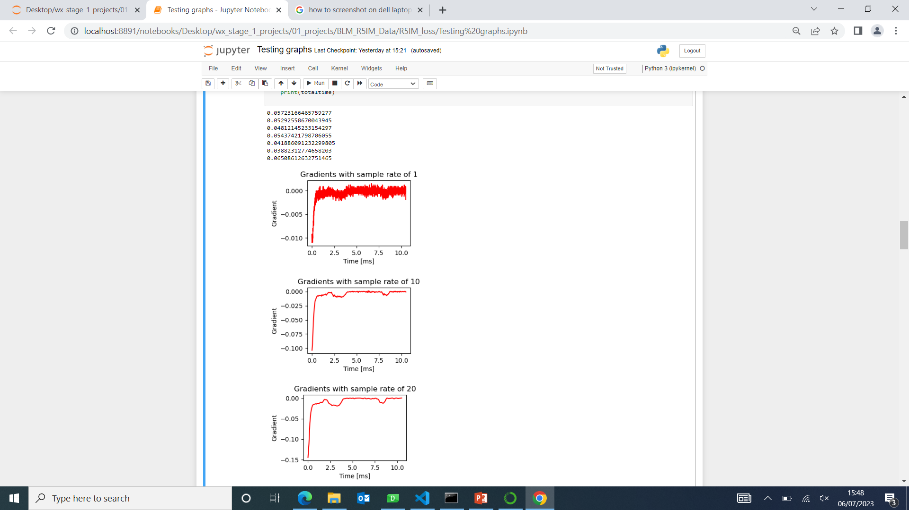
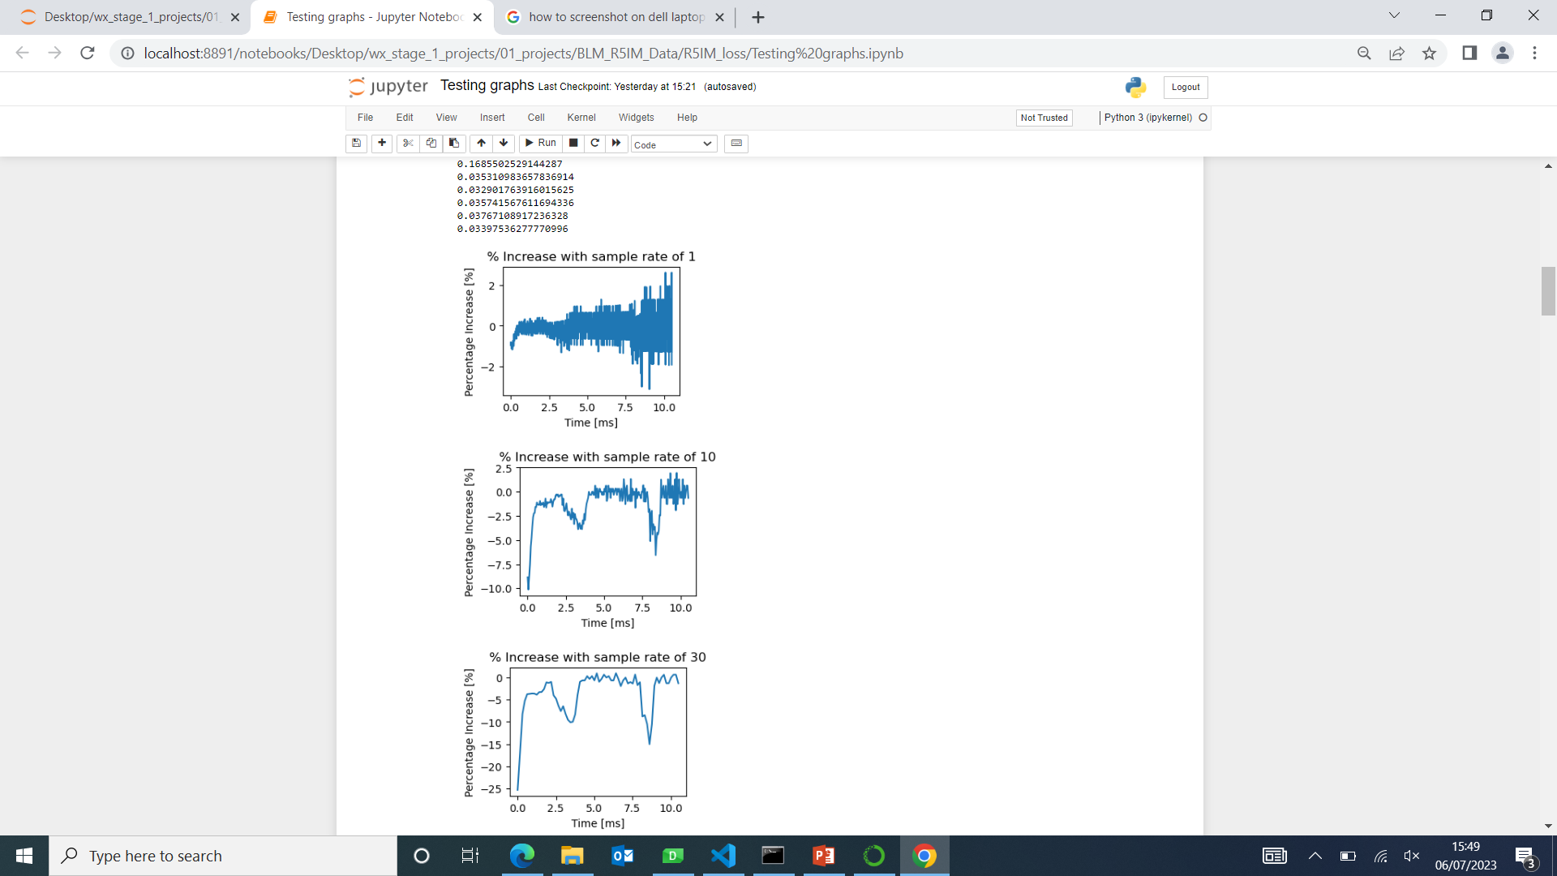
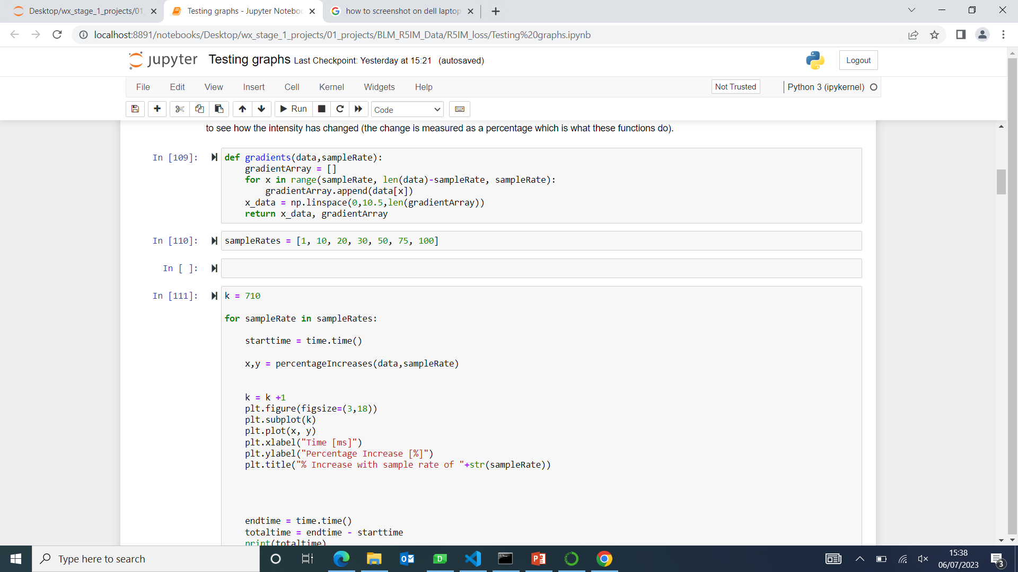
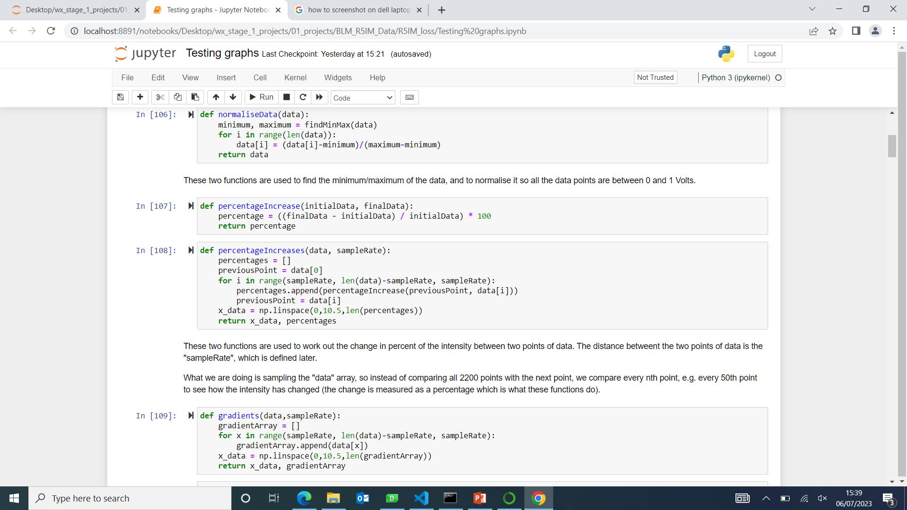

Stage 1: R5IM dips – loss finding

Slide 4
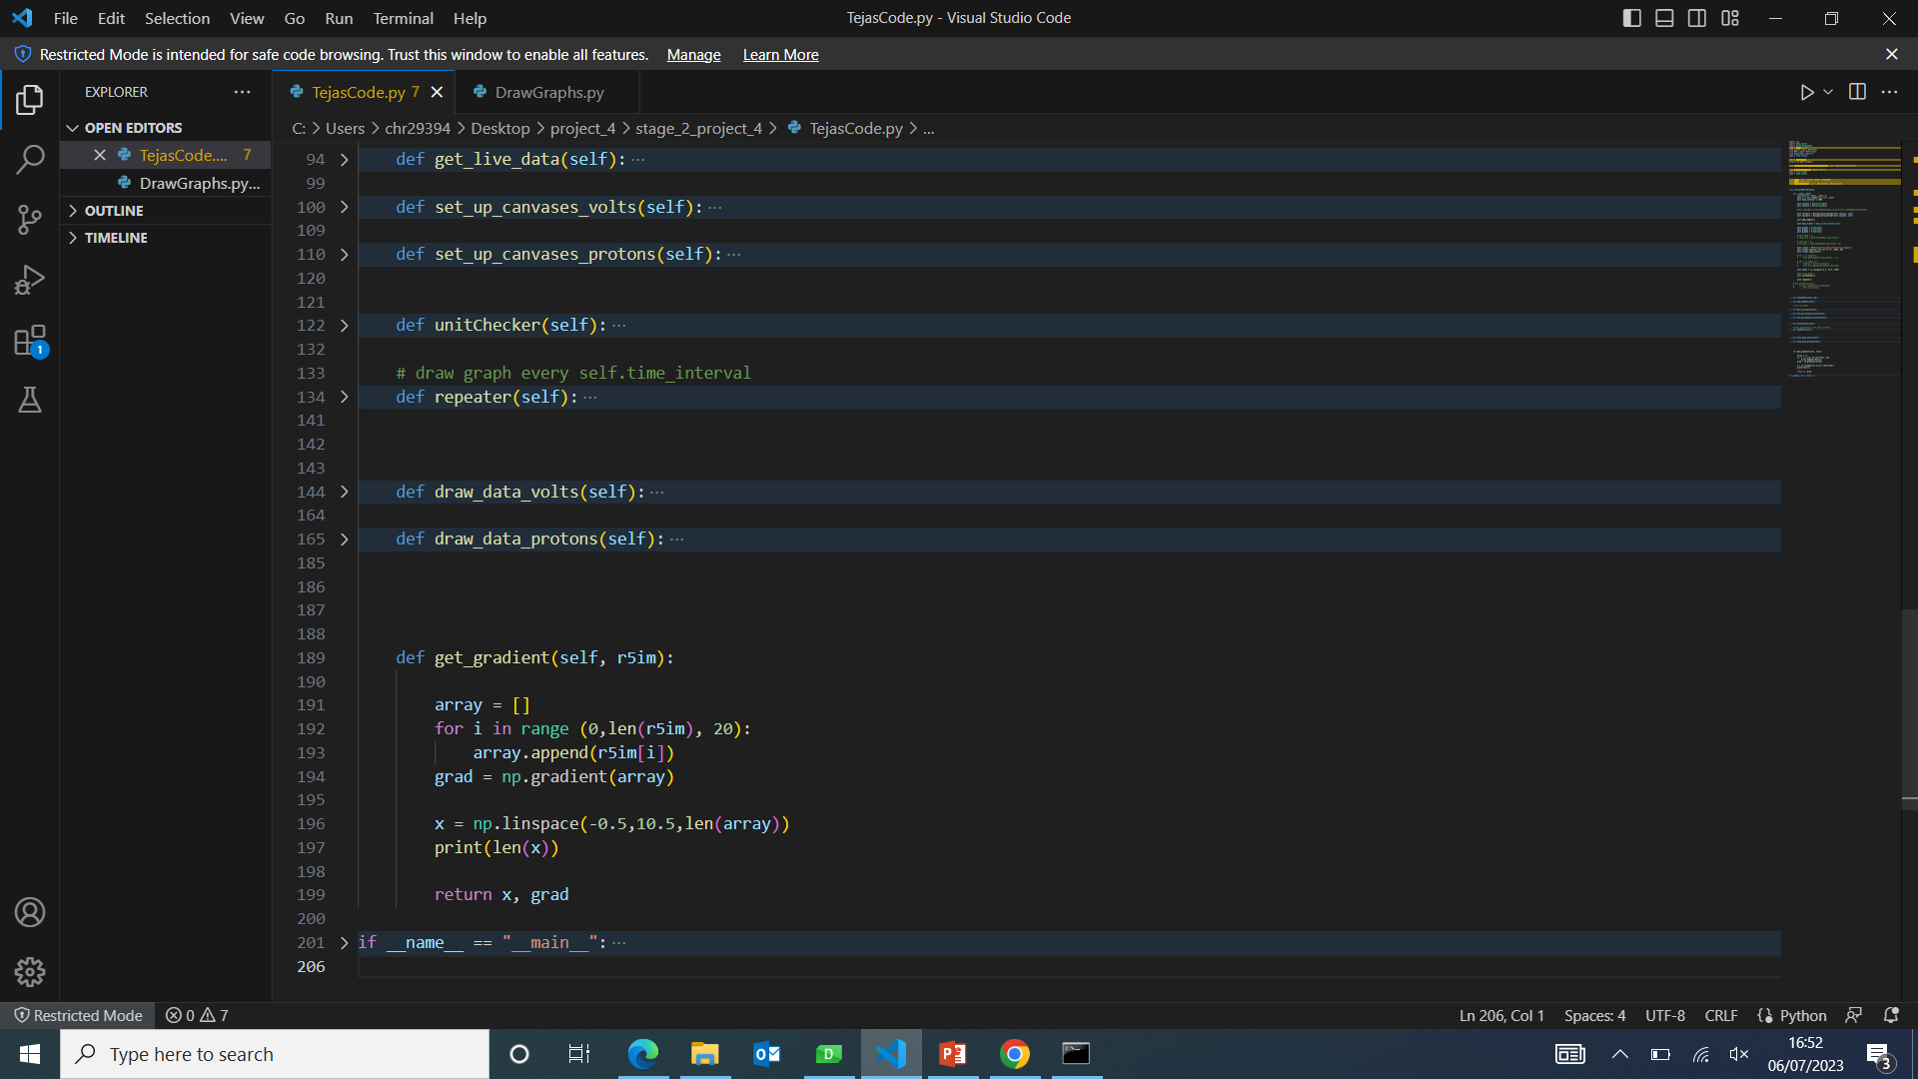
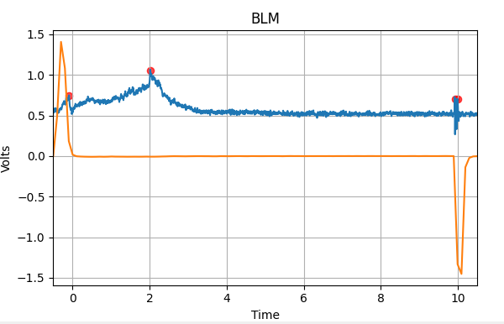
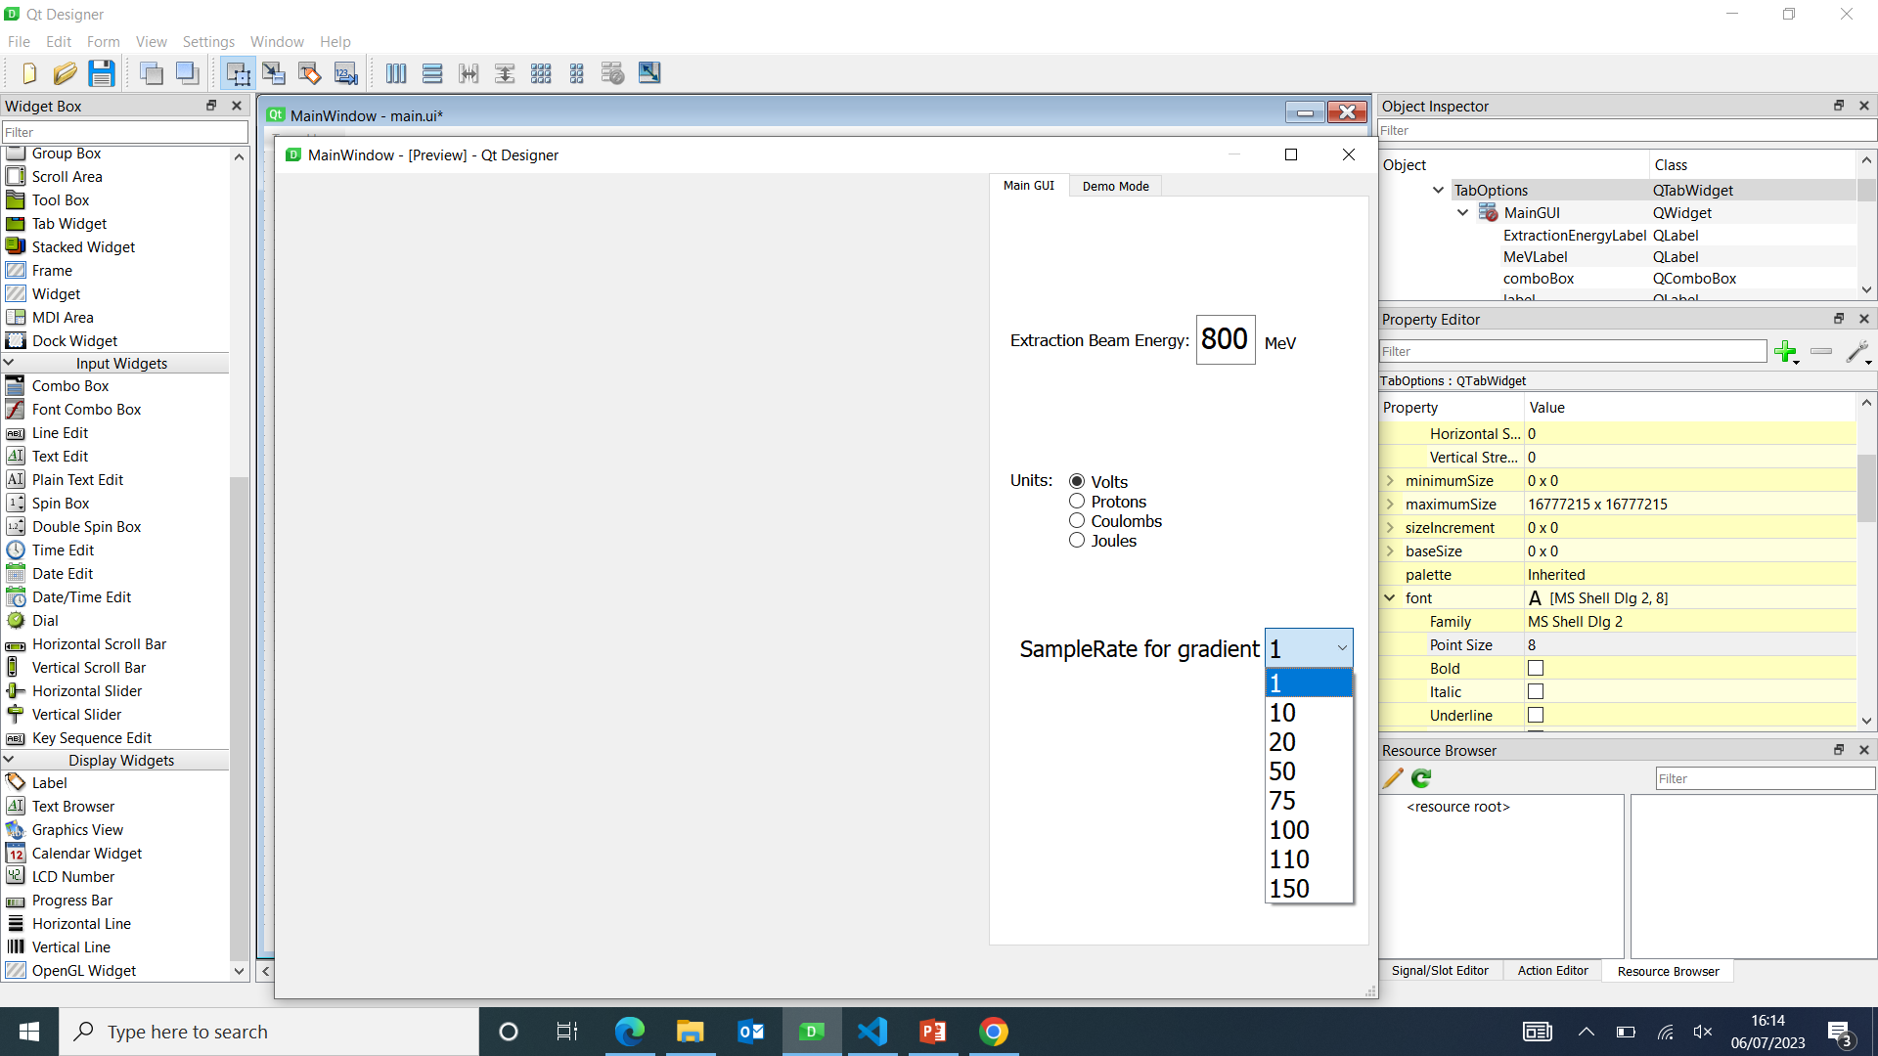
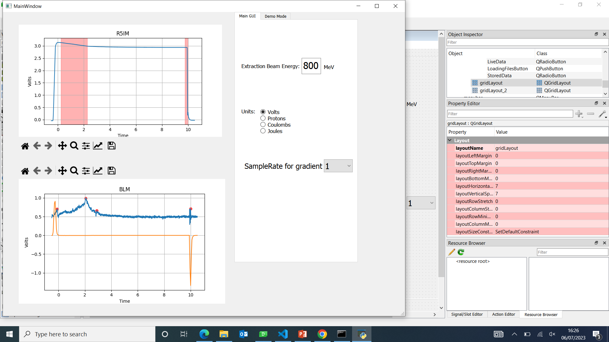
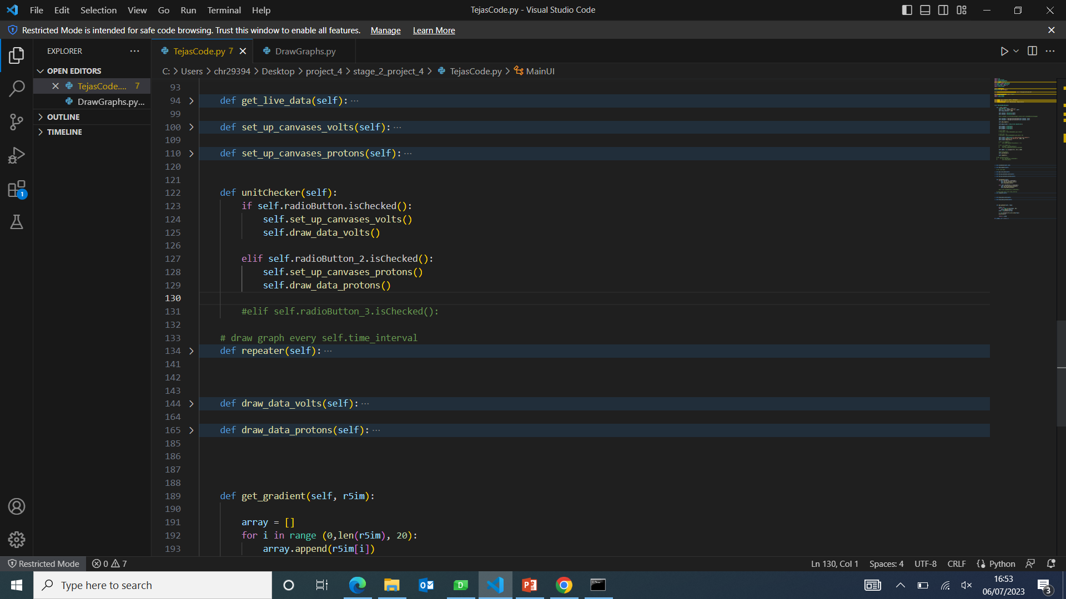
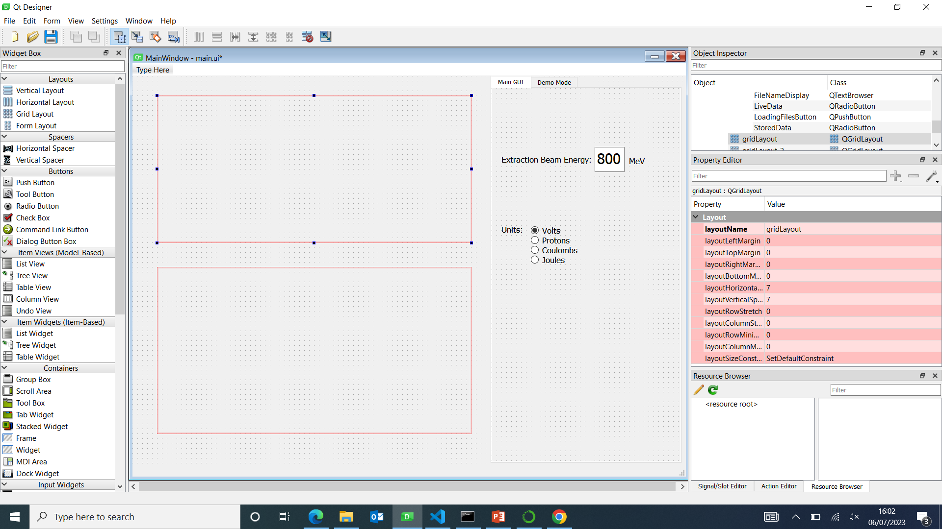
Stage 2: BLM Sum Peak and R5IM Dips

Slide 5
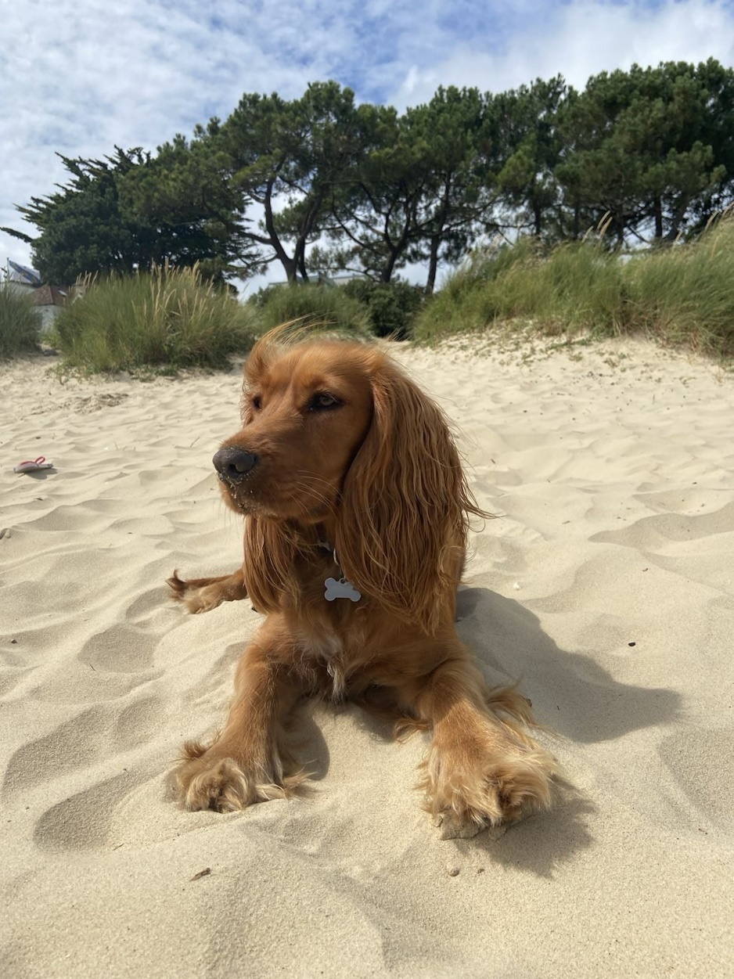
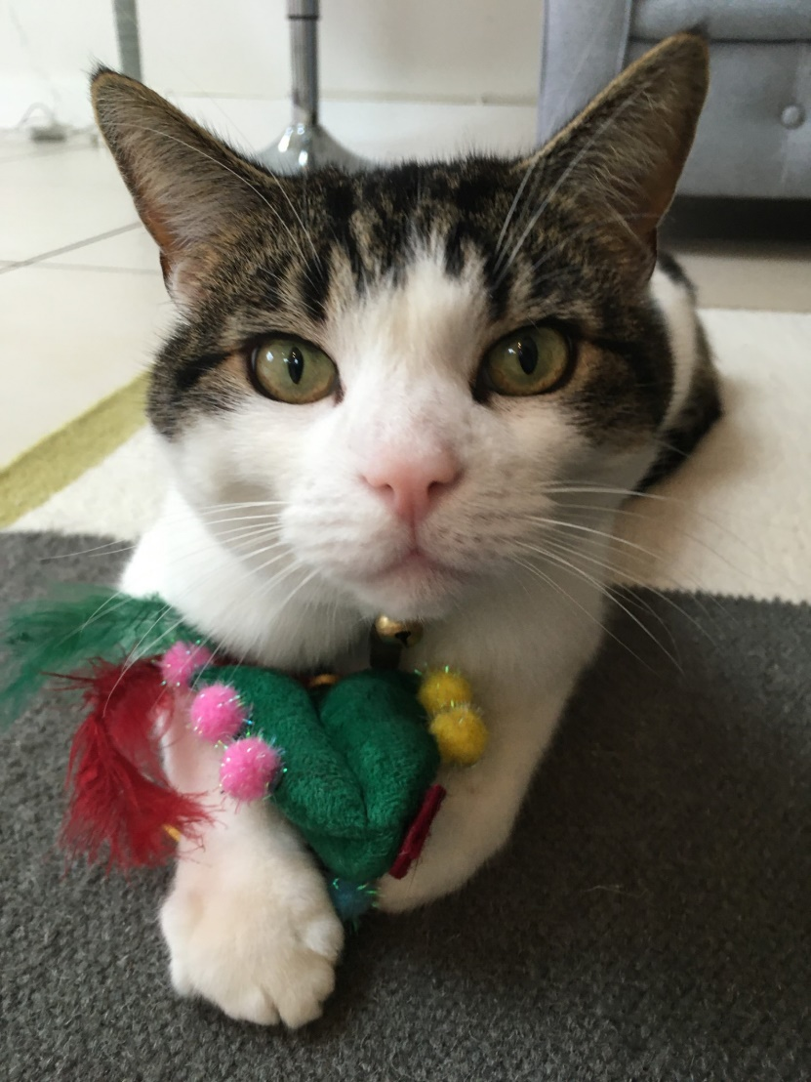
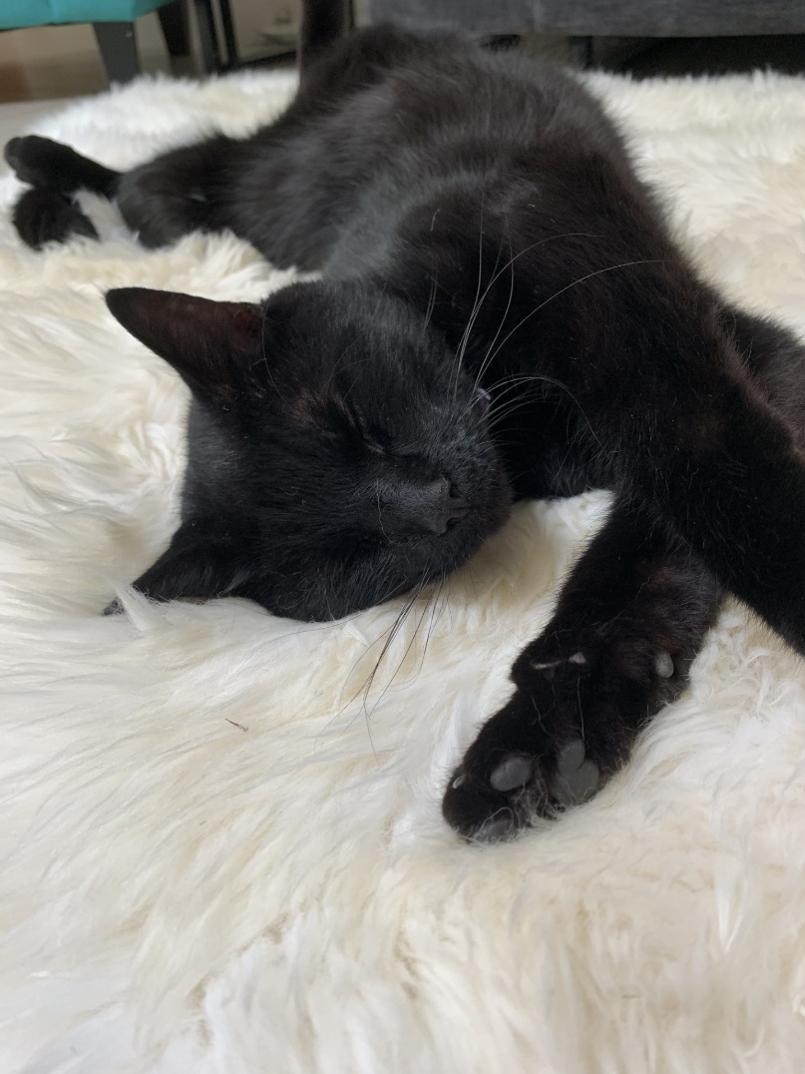
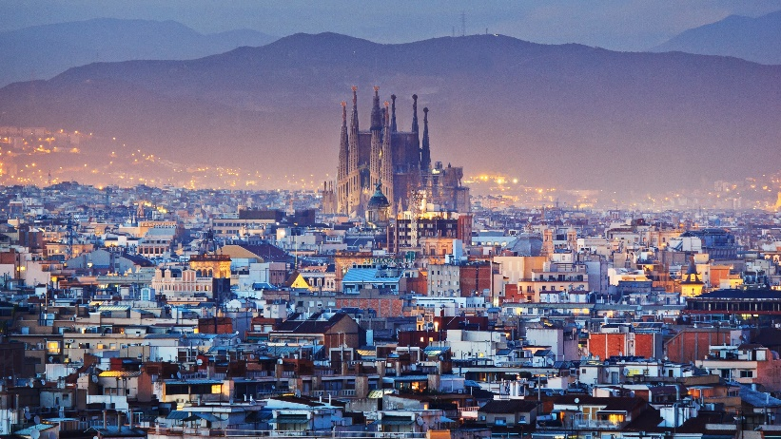



My (Heidi’s) Hobbies and Interests
Two cats and a dog
Used to play cricket and football
Enjoy tennis and running now
Favourite genre: comedies
Want to live abroad
Key takeaways:
Collaborative working
Importance of communication
Enjoy coding, but do not want to be purely a programmer

Slide 6
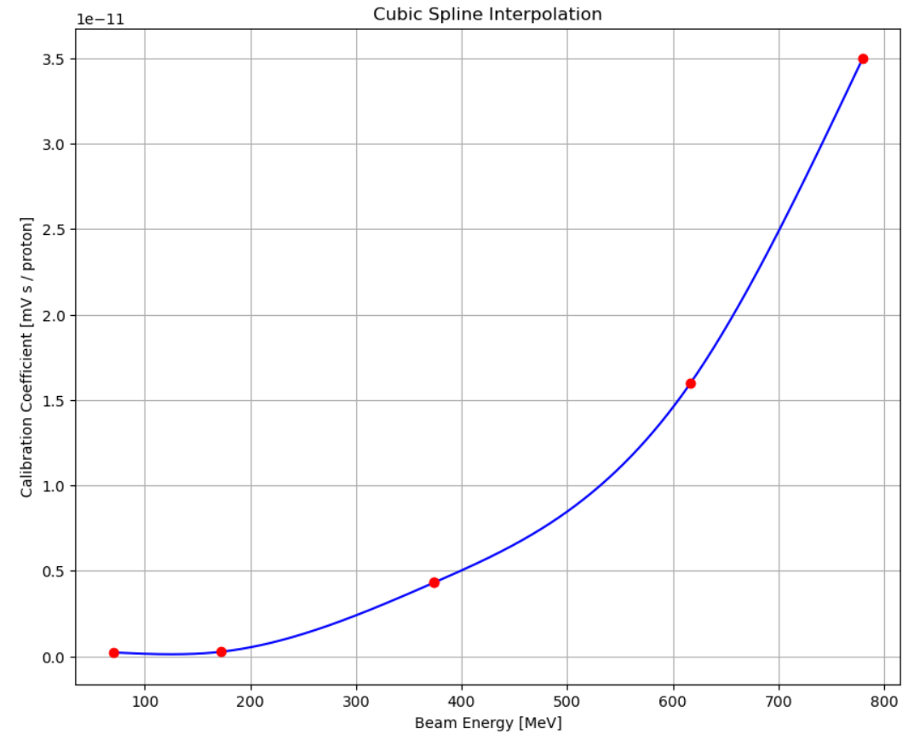
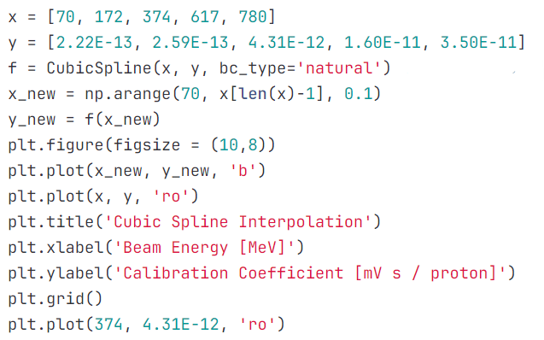
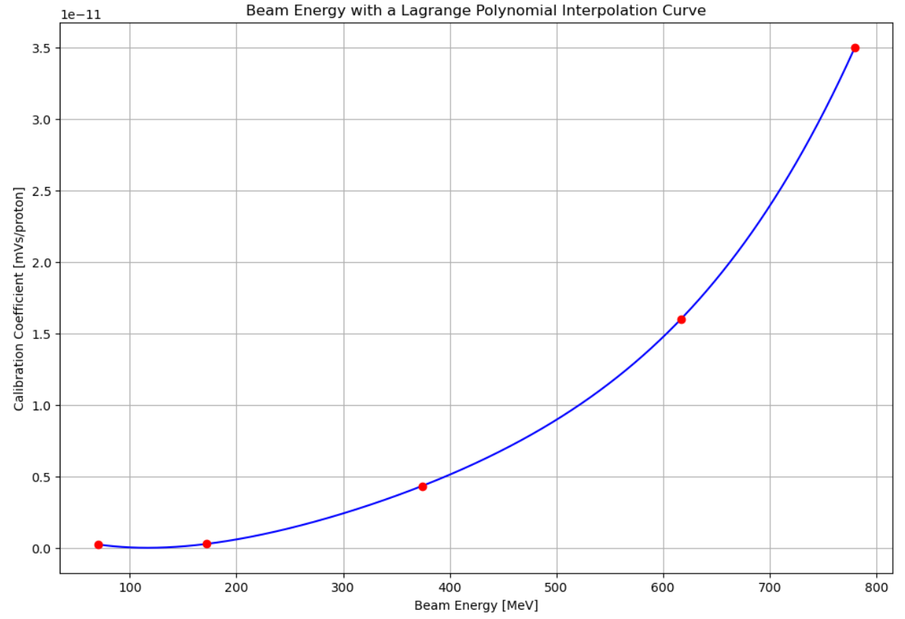
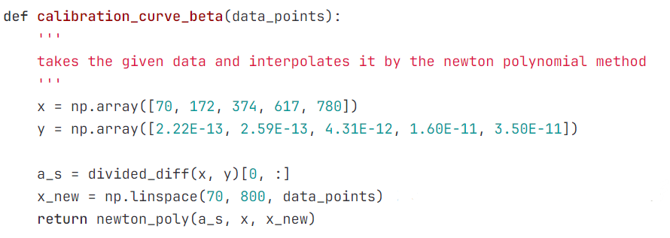
Stage 1 Projects: Group 1F: Energy Conversion With Interpolation
(With Toby and Henrique)
Researched interpolation methods
Created interpolated curves
Extracting calibration curve data
Matplotlib
Git
Notes:
New coding knowledge was overwhelming at first
Ability to use newfound knowledge in applied scenarios

Slide 7
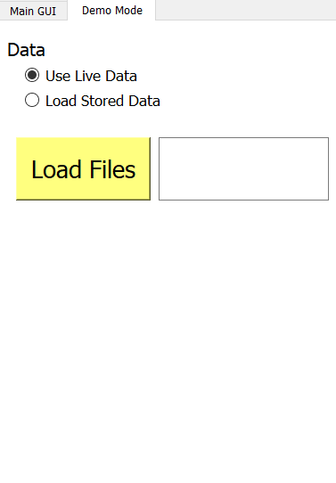
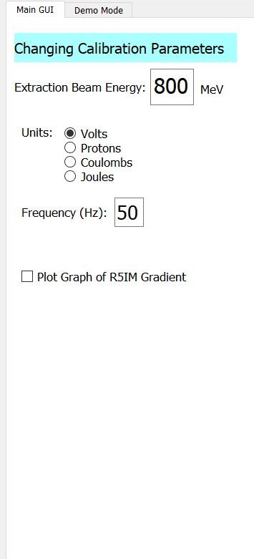
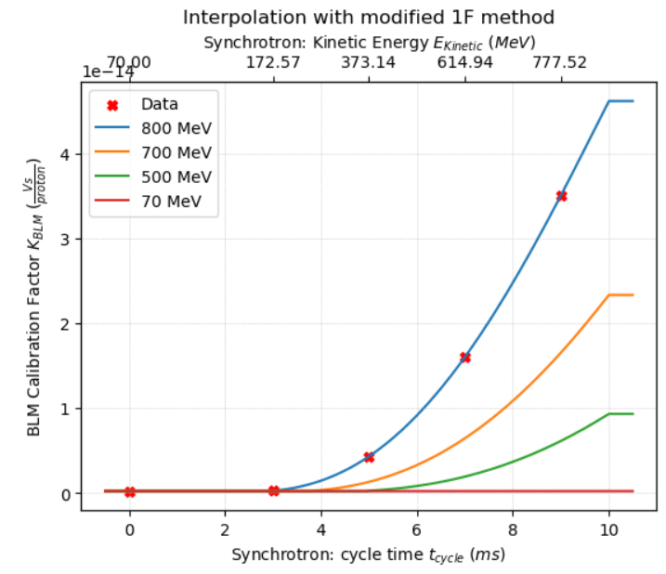
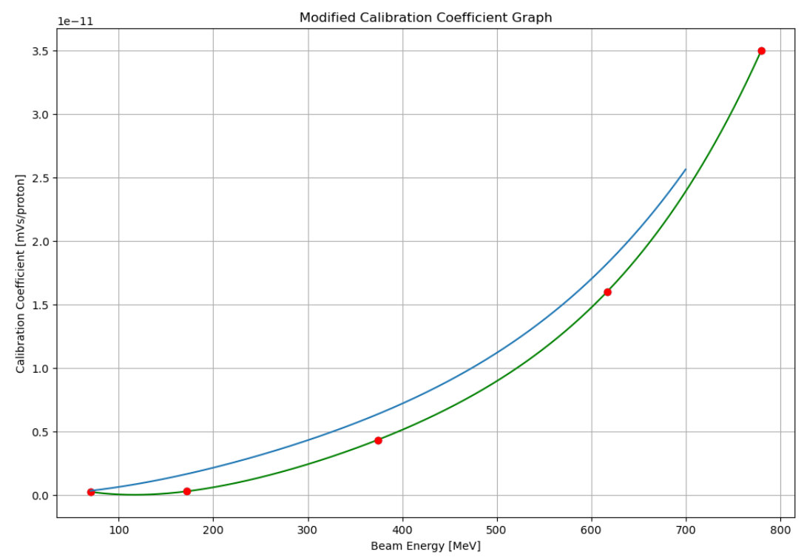
Stage 2 Projects: Synchrotron Loss Finder
Changing beam extraction energy
Difficulty with code
Designed GUI interface
Unit conversion
Enjoyed making a prototype which will be used by scientists
Live data on GUI
Final Graph
(with help from Haroon)
Initial Attempt

Slide 8
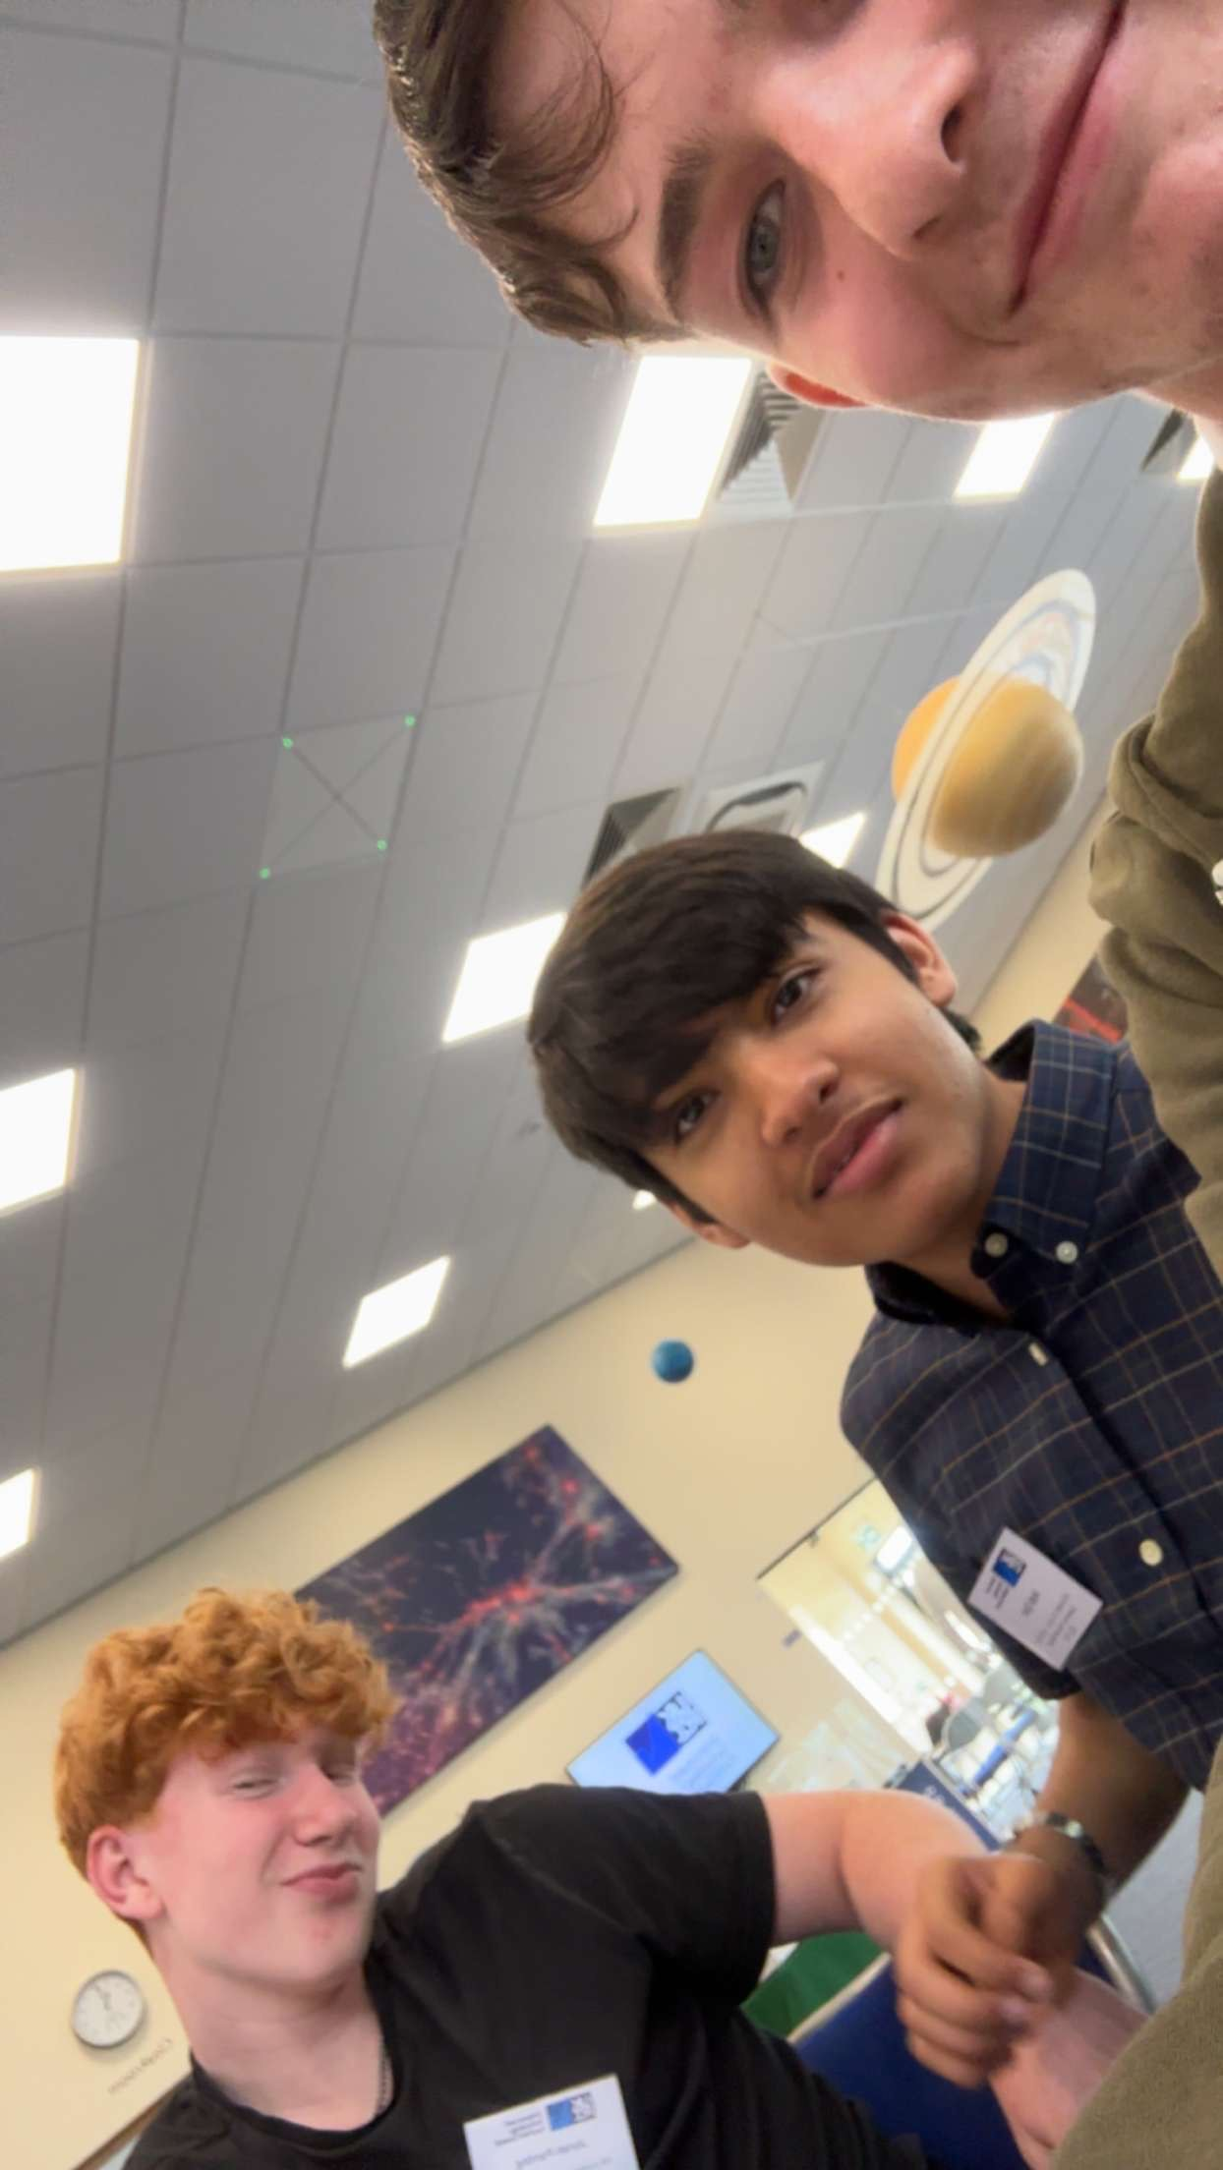
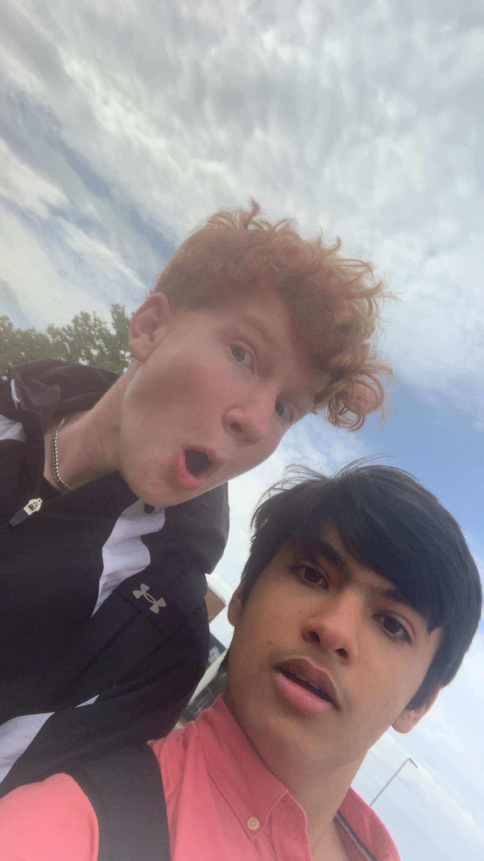
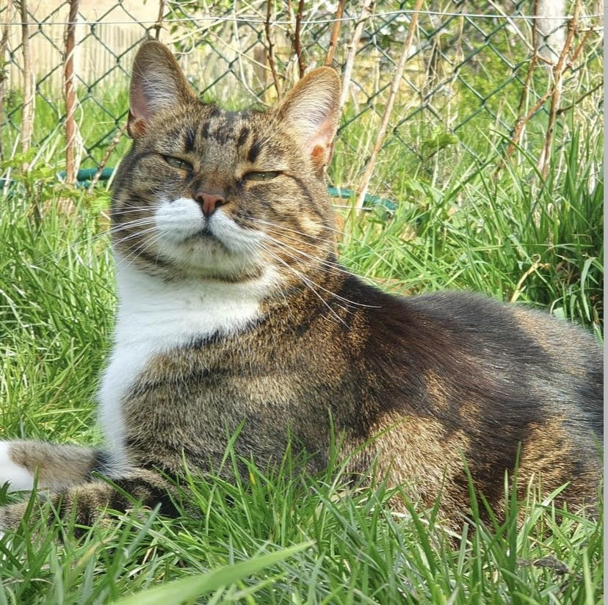
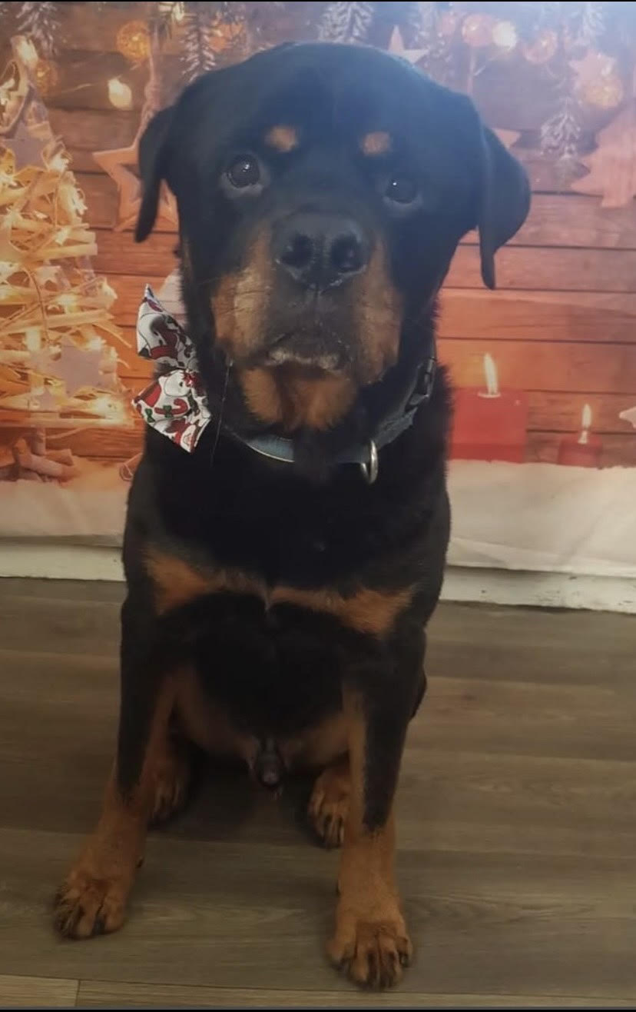

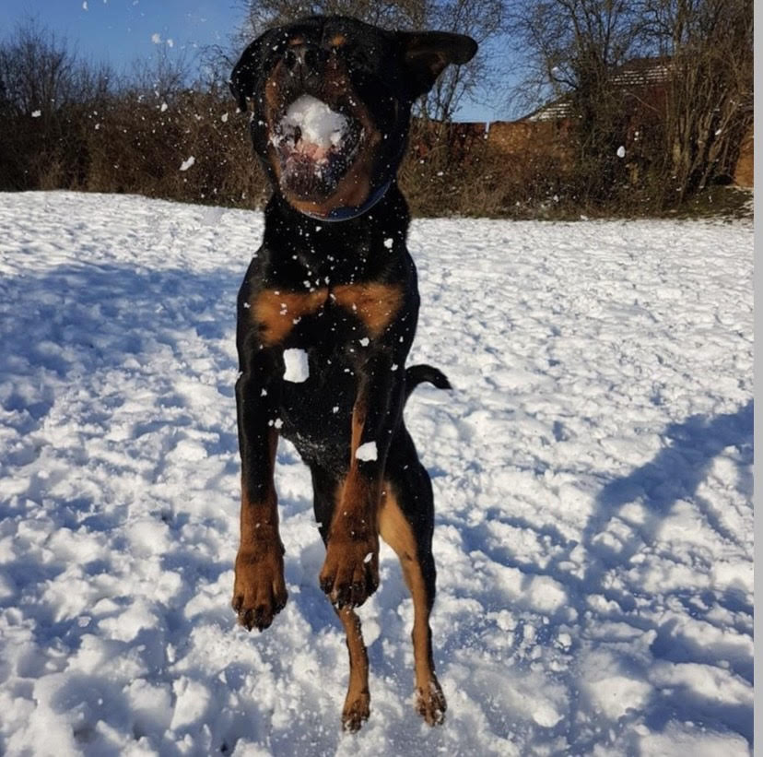
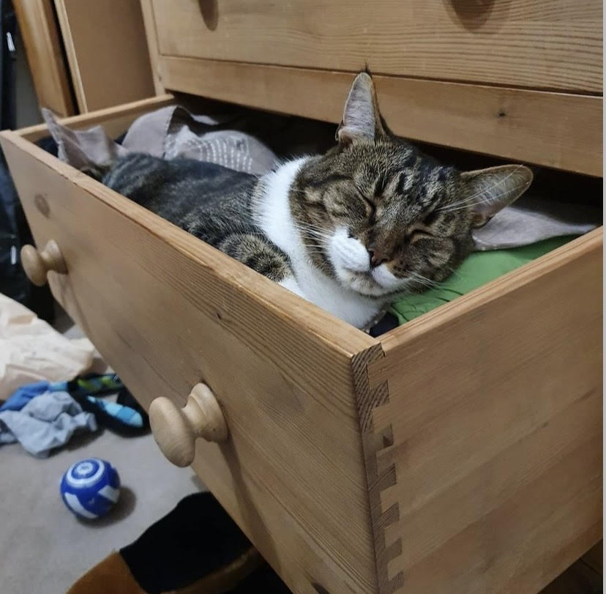


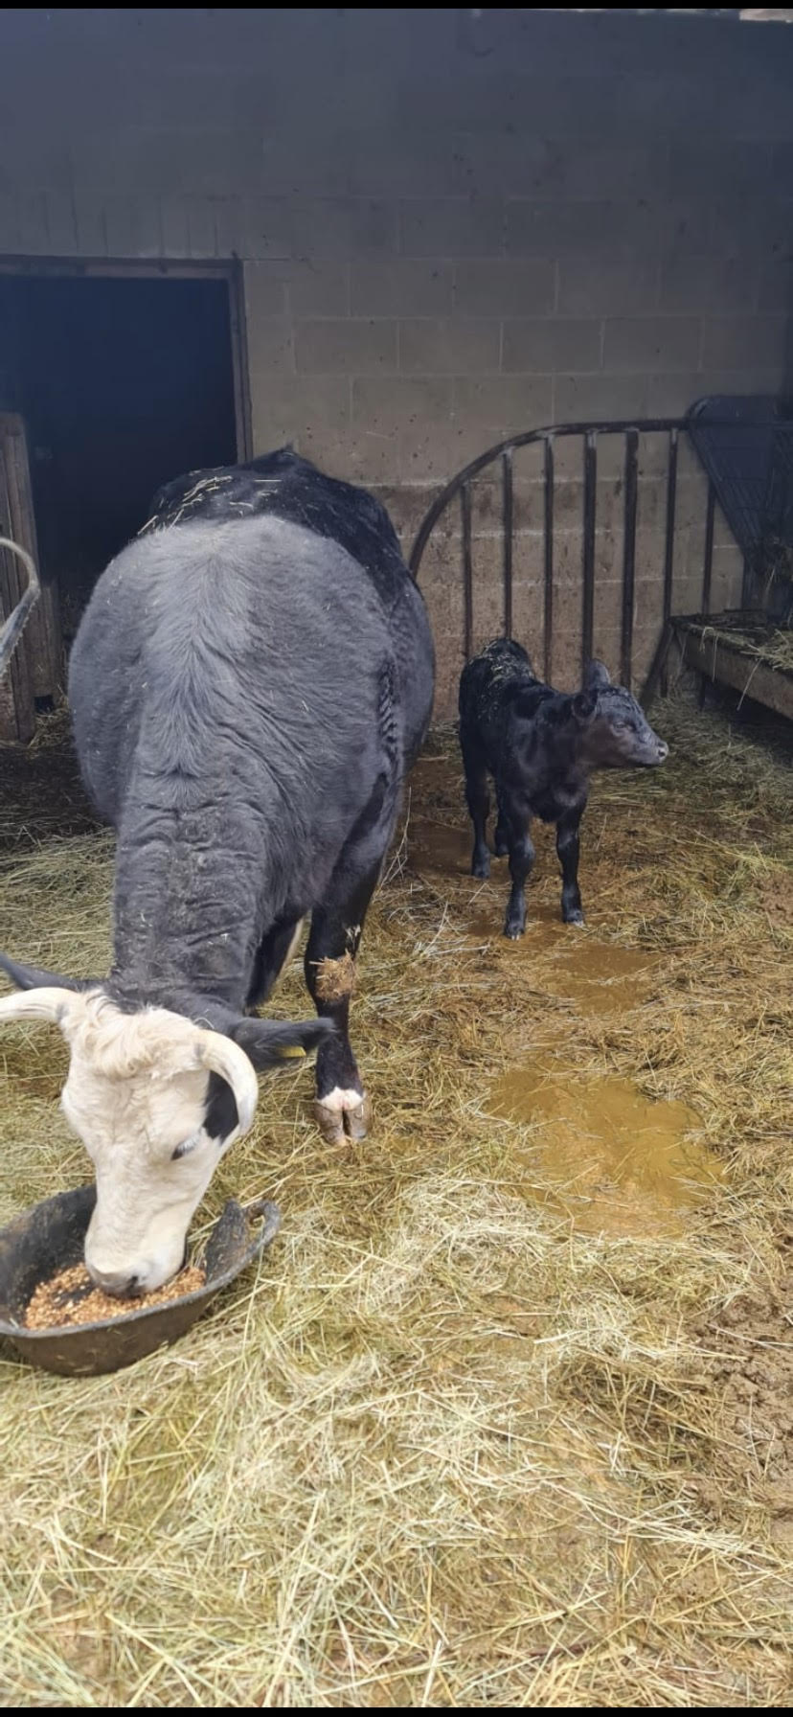
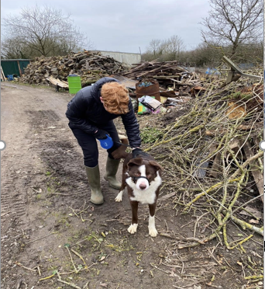
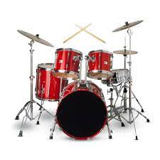
About me!
My life:
Jonah
I love playing sports
I have two pets
Future career path in STEM
Made many great friends
Can play the drums but don’t
do it enough.
Notes:
This has been a brilliant experience for me and I have learnt so much more python
than I knew before.
I am possibly going for a career in science or engineering which I have realised involves a
lot of coding from the guest speeches (they were very helpful for me to gain an idea of future job
aspirations).
Favourite player is Reece James

Slide 9

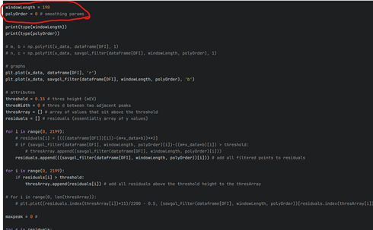
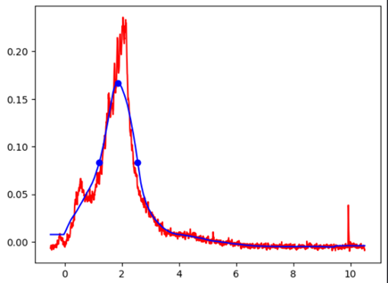
Stage 1 Projects: Group 1D: Peak Finding
My part:
Not much coding experience
Find_peaks and peak prominence
Dimensions for smoothing line
I learnt how to create functions
Really enjoyed coding and learning new code
Notes:
Using a find_peaks function and using a separate peak prominence function to highlight the quantify peaks of the BLMs
Finding the optimum code for the smoothing line which is the blue line on the graph at the top right
Had never made a working function before.

Slide 10
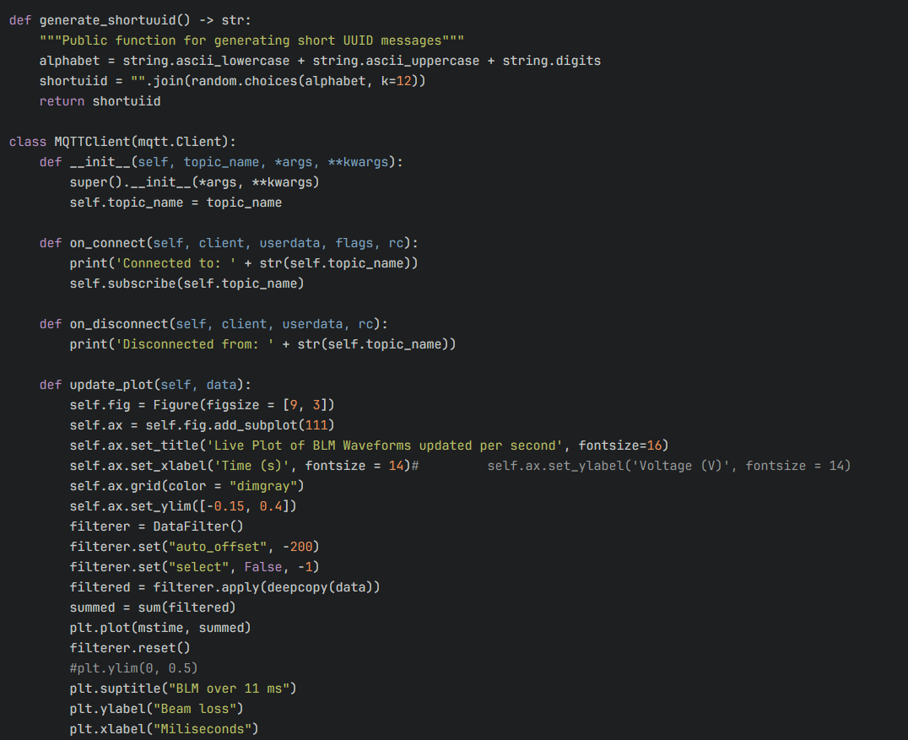
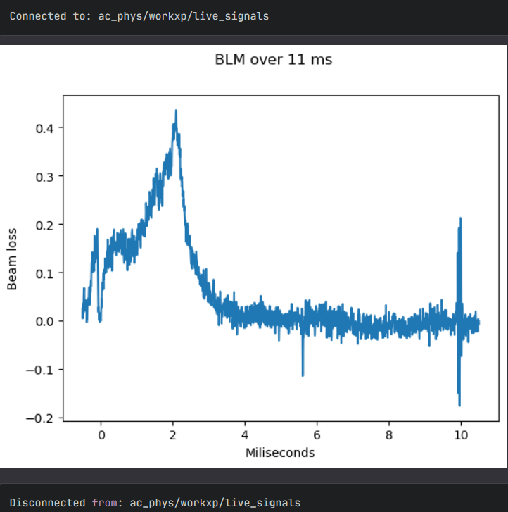
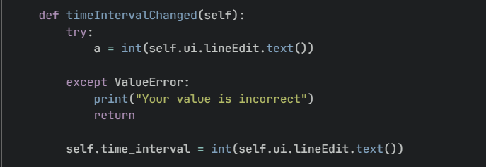
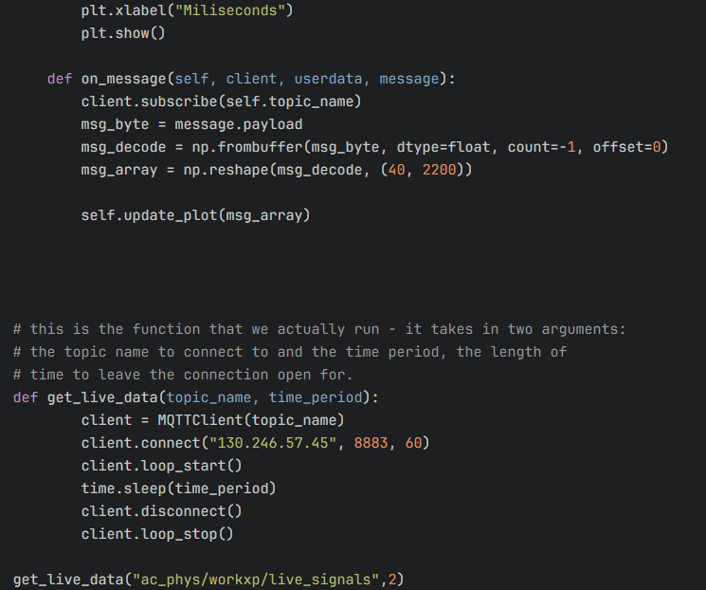
Stage 2 Projects: Peak Finding / R51M Loss
Data frequency function
MQTT code ->
BLM sum data from MQTT
←
My part:
I created a piece of code which allowed MQTT to upload live
data straight to the GUI (sum of BLMs)
Collaborated with other groups to improve my code.
Created a data frequency function.
Learnt how to take data using MQTT and output data files BLMs.
In this placement I have become much more confident with python
(still need a LOT more practice).
Notes:
Data frequency function allows user to change the hz at which the GUI updates.
I’ve had great fun at this experience and

Slide 11


Personal Introduction & How Has This Work Experience Benefited You?
Rory
Experience in collaborating with others on projects
Experience in solving real world problems

Slide 12
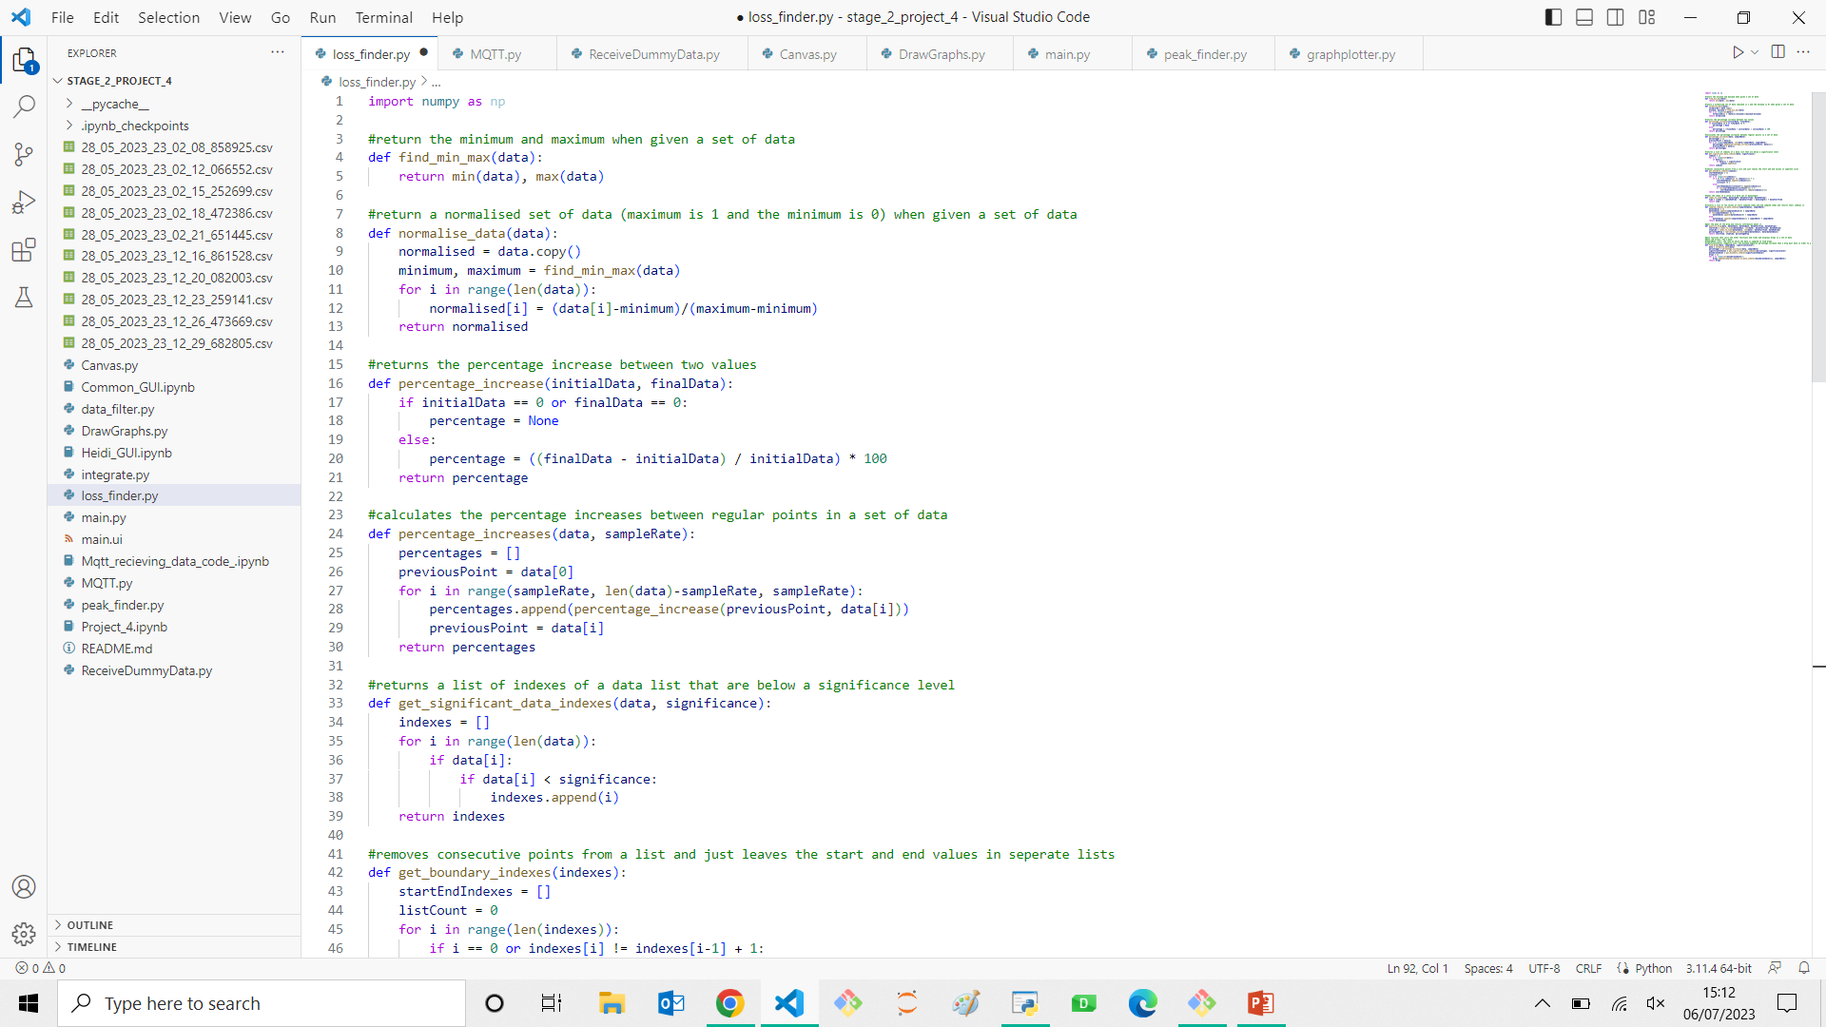
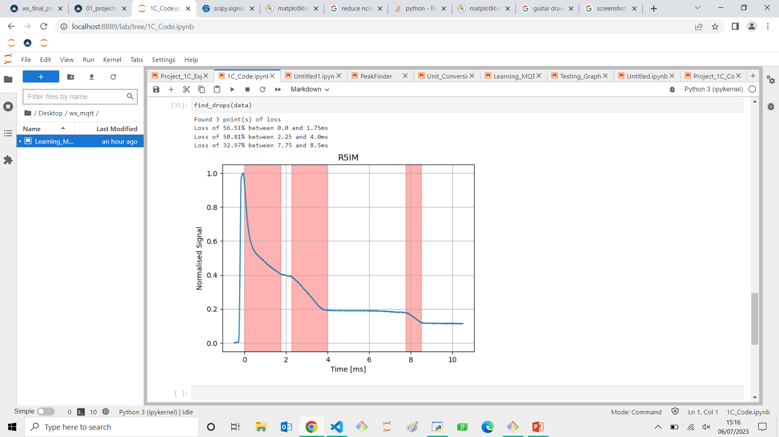
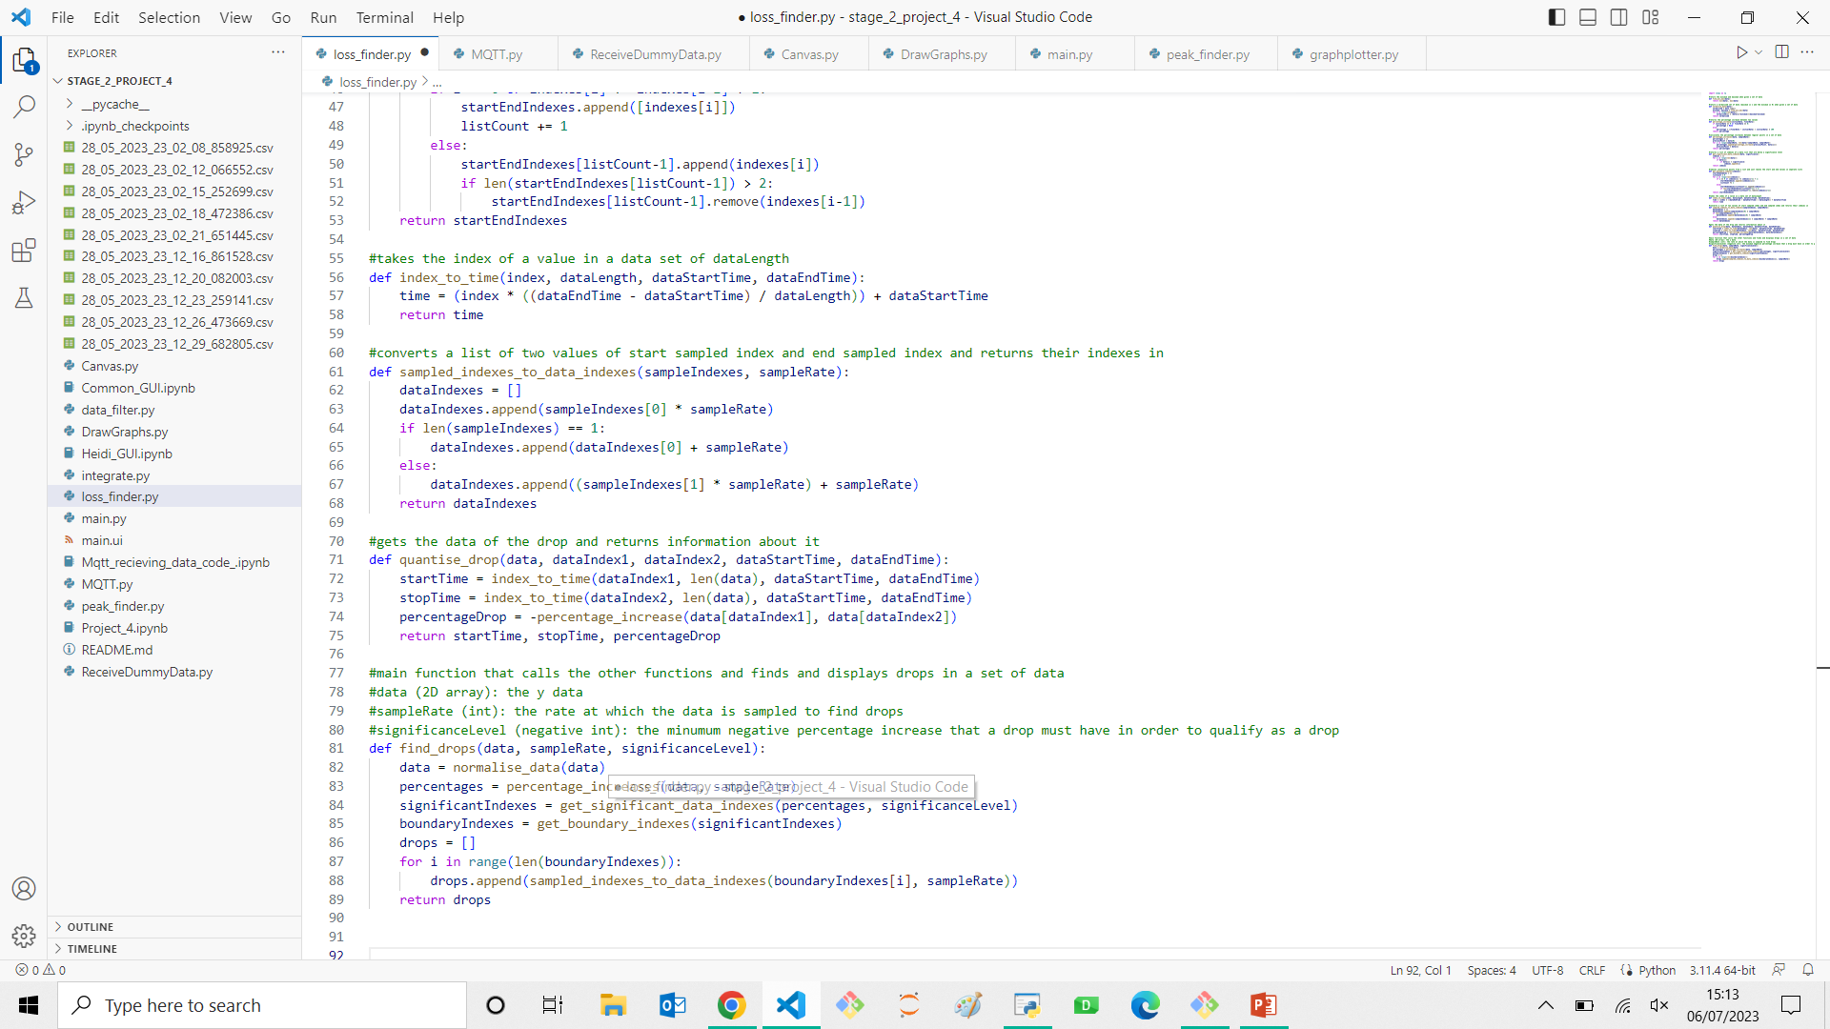
Stage 1 Projects: Group 1C: Data Analysis: Loss finder
Main coder for our loss finder
What I learnt:
Data analysis with programming is a lot more complex than I first thought

Slide 13
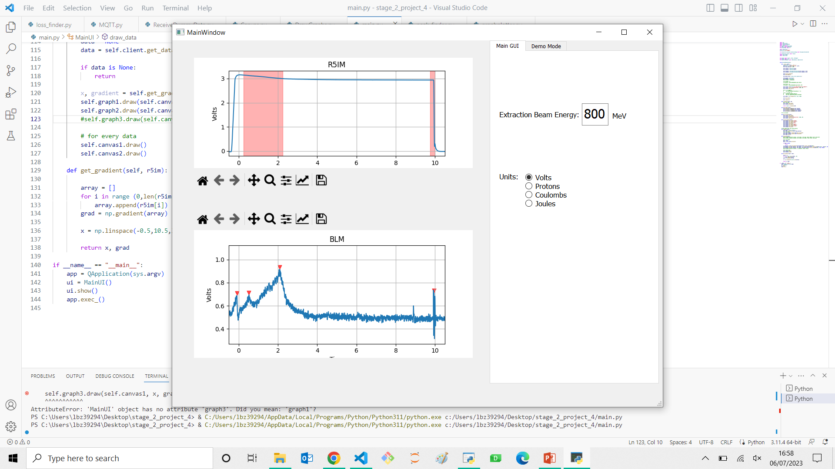
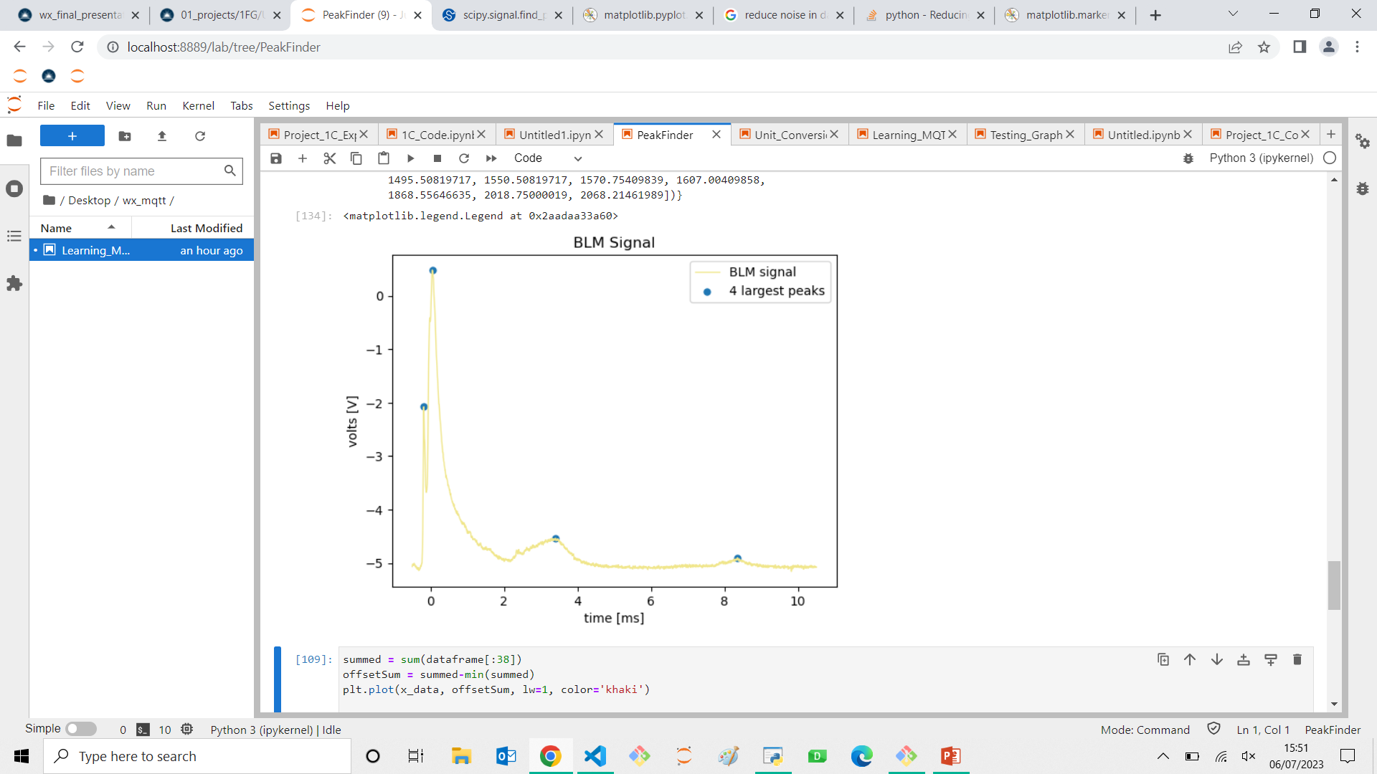
Stage 2 Projects: R5IM Loss & BLM Peak Finder
In charge of the R5IM Loss and the BLM Peak Finder
Altered the code significantly for both so that they function and so that they function in the GUI
Implemented them into the GUI
What I learnt:
Data analysis with programming is even more complex than I first thought

Slide 14


Vlad Ersteniuk

Slide 15
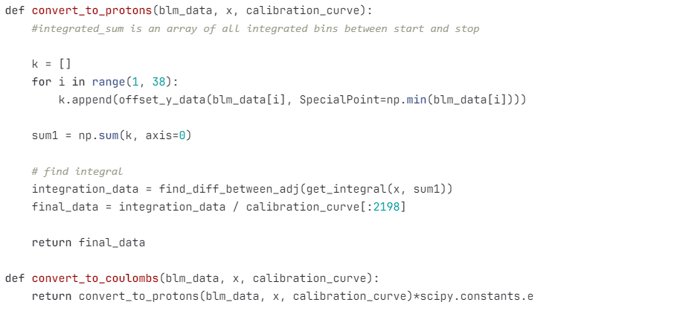
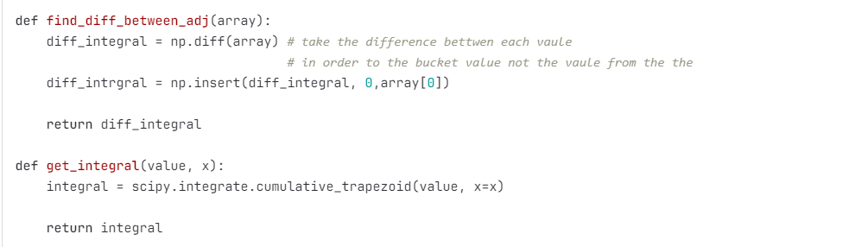
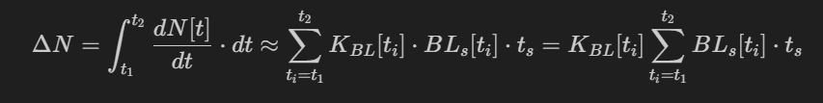
Stage 1 Energy Conversion: Integration and units conversion

Slide 16
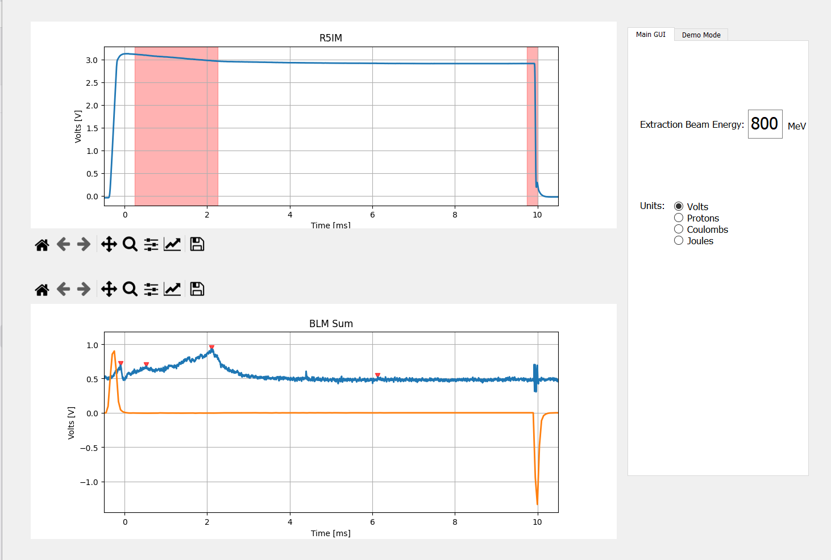
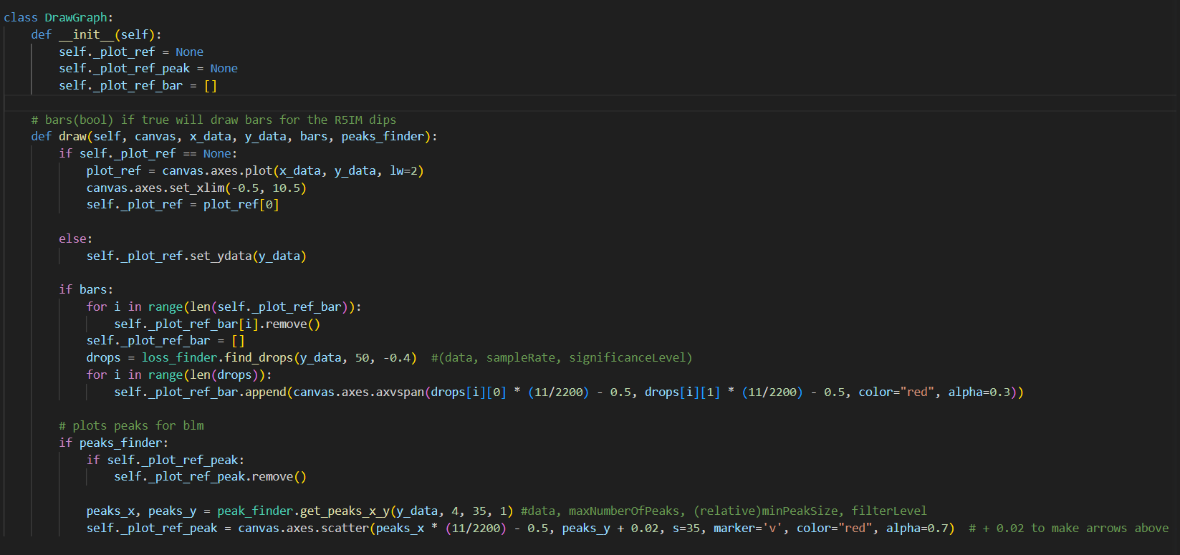
Stage 2: R5IM Loss & BLM Peak Finder

Slide 17
Acknowledgments
We would like to thank:
The Public Engagement Team
Haroon
Esher
Bill
Pamela
Reception Team
And other people who came to inspire us with their personal career stories

Slide 18
GUI Demo

Slide 19
Thank you
Questions?

